Slide 1






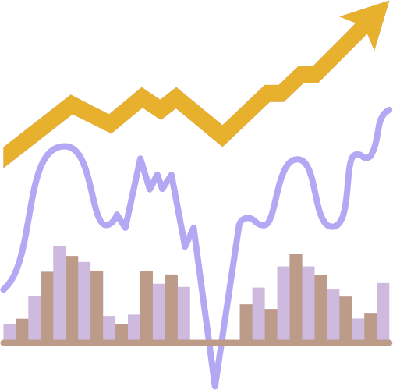







February 2023
Group 3
Add your idea here
FINANCIAL STOCK DATA MODEL
Add your idea here
By Abraham Ofolu, Anderson Safo, Charlotte Large, Lionnel Tembu and Siyuan Liang
.
Add your idea here

Slide 2






Introduction
Data Exploration and cleaning
TABLE OF CONTENTS
Long Short Term Memory
Data Visualisation
Conclusions and Limitations

Slide 3





INTRODUCTION
Stock market data can be interesting to analyse and as a further incentive, strong predictive models can have a large financial payoff. The amount of financial data on the web is seemingly endless. A large and well-structured dataset on a wide array of companies can be hard to come by.
Our project aims to analyse and make use of historical stock prices, provide an analytical interpretation of the changes and trends, and forecast how those same stock prices will behave in the future.
We will load data using python script and sklearn. We have chosen to use a LSTM model for financial stock data. Our model predictions and overall performance will be printed and saved as a csv file.

Slide 4
DATA EXPLORATION AND CLEANING
The data was acquired from Yahoo Finance.
The technologies we have decided to use are:
PYTHON
SKLEARN
KERAS
TABLEAU
GOOGLE COLAB

Slide 5



LONG SHORT-TERM MEMORY
An LSTM was chosen for analyzing stock price data because it excels at modeling sequential data.
Its unique architecture allows it to store and utilize past information to make accurate predictions, making it well-suited for analyzing stock price patterns, which often exhibit trends and dependencies over time.
By leveraging the memory cells in the LSTM, we can incorporate information about past stock prices and use this to better predict future trends.

Slide 6

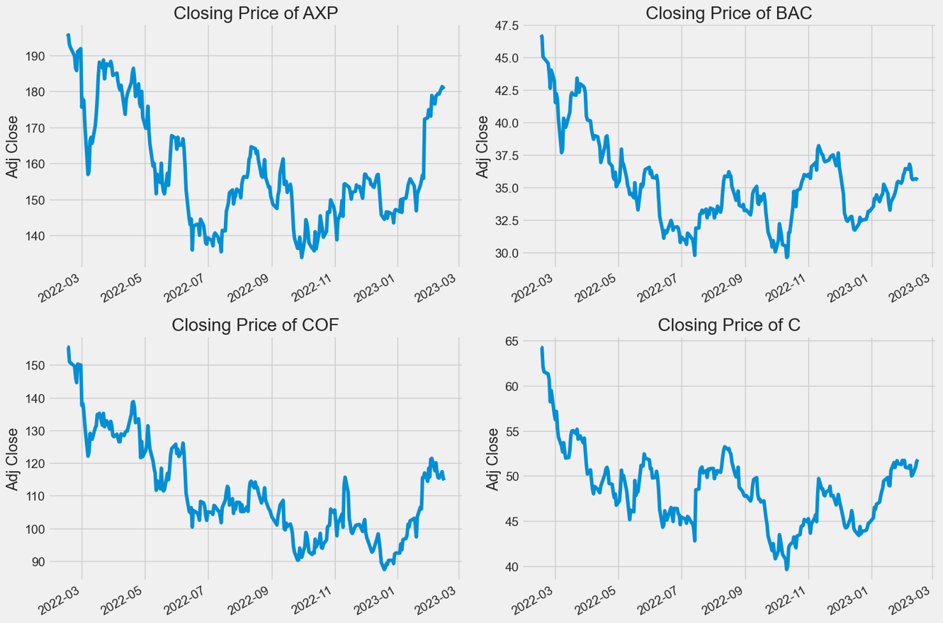

CLOSING PRICE
The closing price is the final price of a stock traded in a regular trading day, and it's the standard benchmark for investors to track its performance.

Slide 7

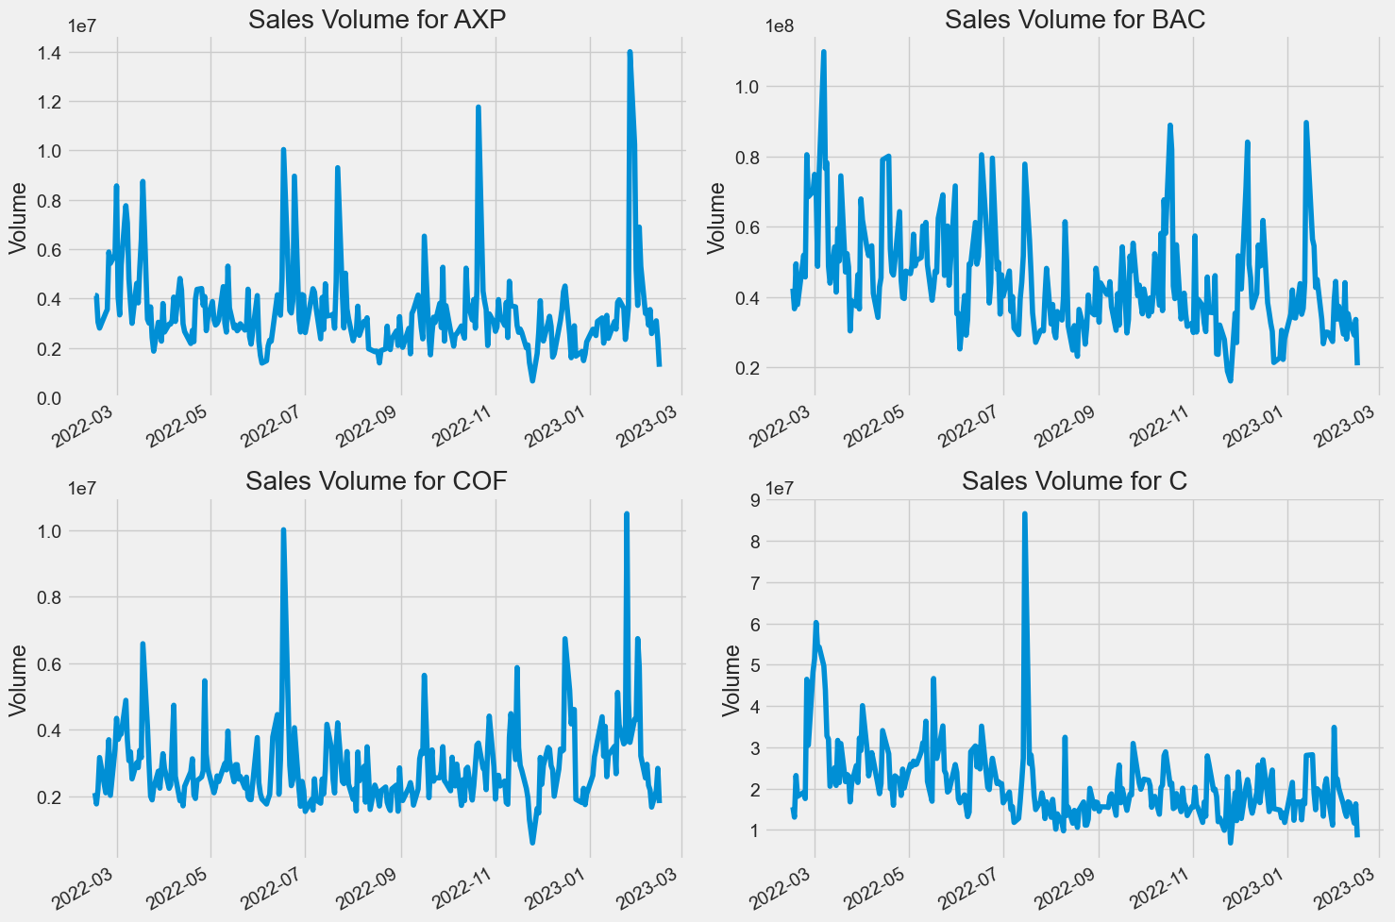
VOLUME OF SALES
Volume is the quantity of a security or asset traded over a period, usually in a day. It refers to the number of shares exchanged between the open and close of trading. Technical traders rely on trading volume and its changes over time.

Slide 8
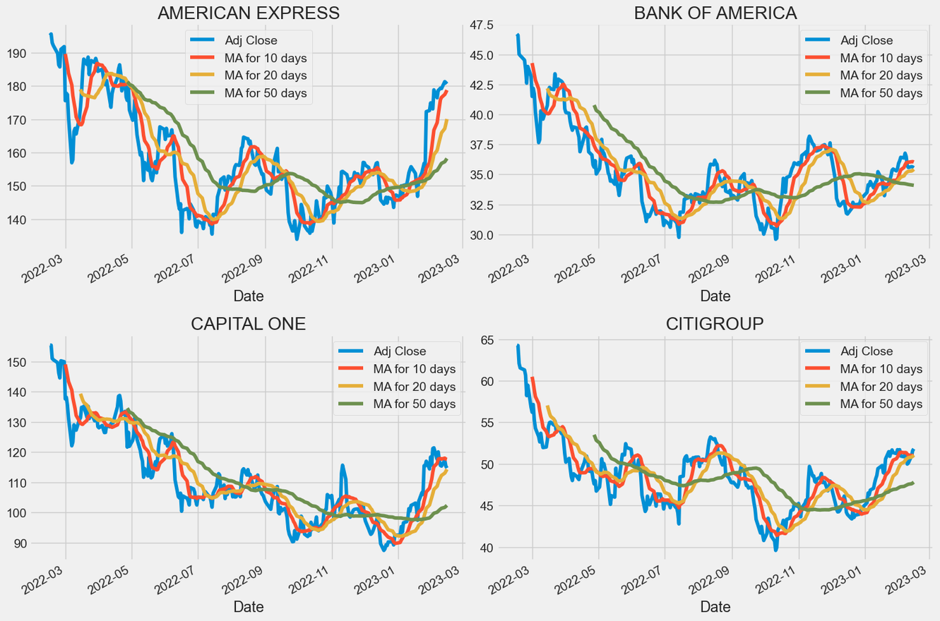

MOVING AVERAGE OF THE STOCKS
The moving average (MA) is a basic technical tool that evens out price data by generating a continuously updated average price over a particular period, such as 10 days, 20 minutes, or 30 weeks, according to the trader's preference.

Slide 9

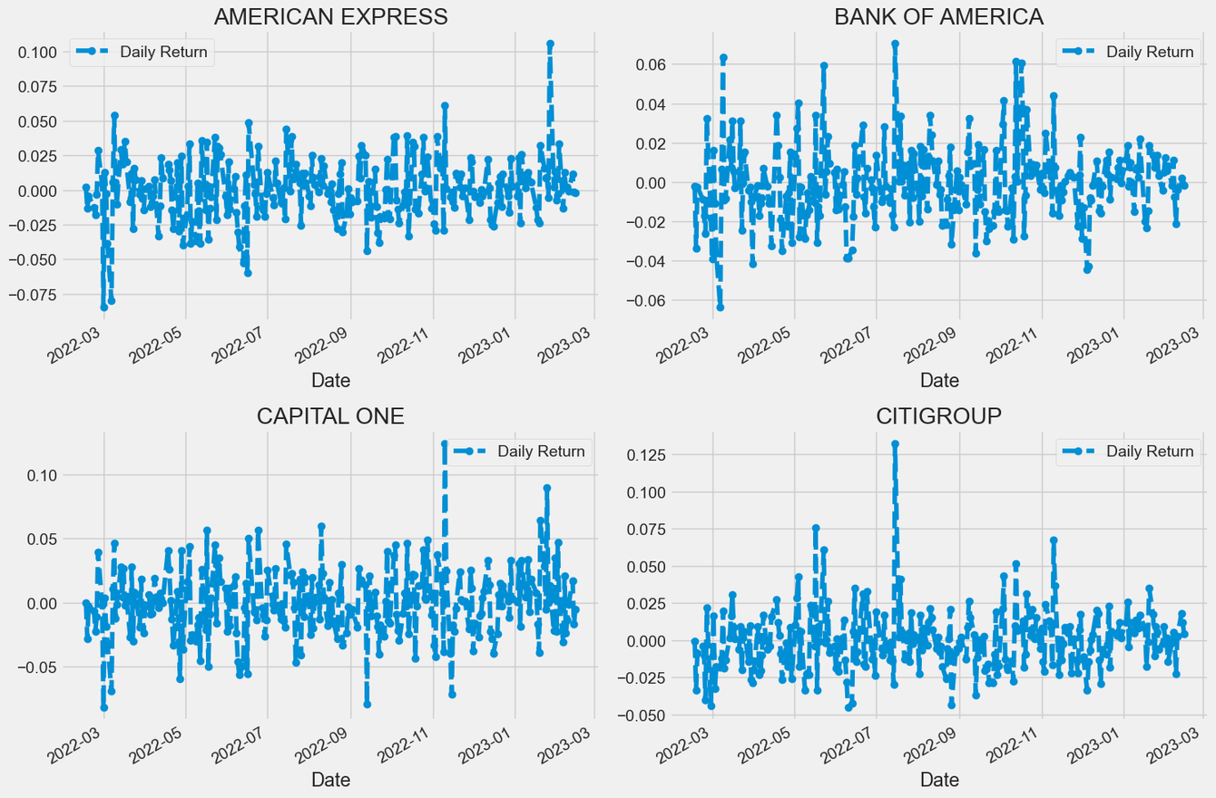
AVERAGE STOCK RETURNS
The average return is the mathematical average of a sequence of returns that have accrued over time. In its simplest terms, the average return is the total return over a time period divided by the number of periods.
The average stock market return has been about 10% per year for nearly the last century, as measured by the S&P 500 index. In some years, the market returns more than that; in other years, it returns less. Investors can use this bench march as a way to analyse which stocks will generate the most return on average and it is a variable crucial and also frequently used in forecasting

Slide 10
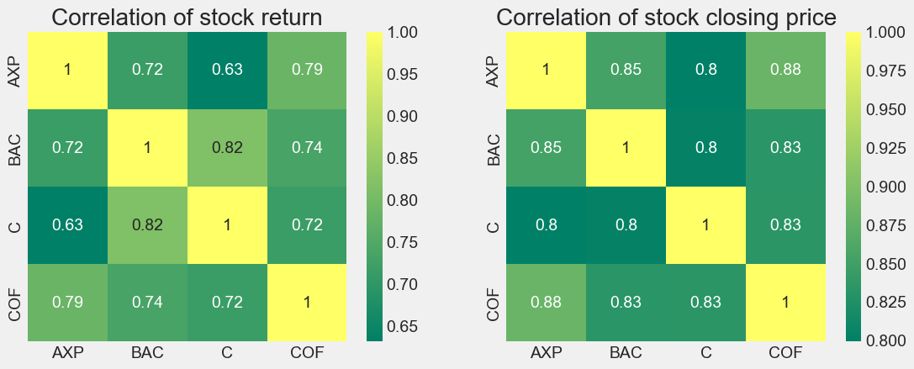
CORRELATION OF CLOSING PRICES BETWEEN DIFFERENT STOCKS

Slide 11
CONCLUSIONS
The average stock market return has been about 10% per year for nearly the last century, as measured by the S&P 500 index. In some years, the market returns more than that; in other years, it returns less. Investors can use this bench march as a way to analyse which stocks will generate the most return on average and it is a variable crucial and also frequently used in forecasting.
The model demonstrates meaningful predictive power at least 75% classification accuracy or 0.80 R-squared.

Slide 12
LIMITATIONS
stock prices are influenced by company news as well as other factors such as demonetization or company mergers and demergers. In addition, many intangible variables are difficult to predict in advance.

Slide 13

QUESTIONS?

Slide 14



REFERENCES
https://github.com/CNuge/kaggle-code
https://www.kaggle.com/datasets/hershyandrew/amzn-dpz-btc-ntfx-adjusted-may-2013may2019
THANK YOU

